Slide 1
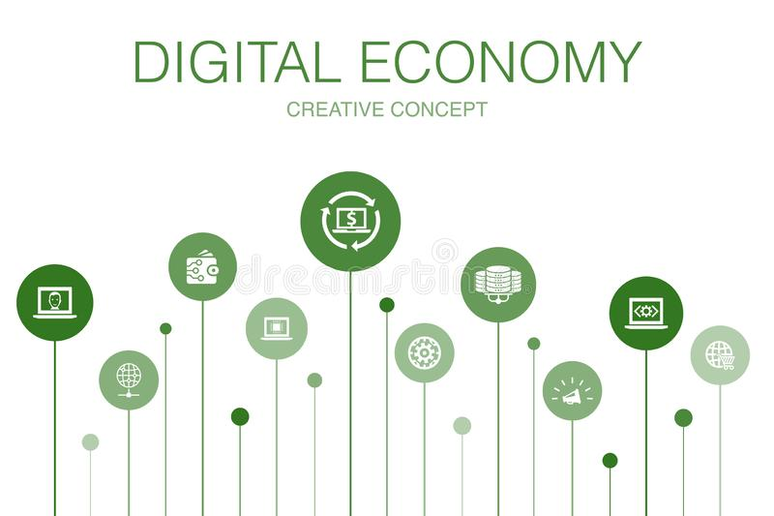

Slide 2
Let’s Start With Some Creative Concept of Digital Economy
Tell me Any Idea About Digital Economy ?
What is the difference between ECONOMICS and ECONOMY?

Slide 3
What is the difference between ECONOMICS and ECONOMY?
ECONOMICS
ECONOMY
Economics is the science that studies economies and develop possible model for their functioning .
Economics is the science and art of decision making , regarding the use of scarce resources under the condition of scarcity , to attain maximum satisfaction .
When a country or a geographical region is defined in the context of its economic activities , it is known as economy and economics system .
The relationship between production , trade and supply of money in a particular country or region .

Slide 4
What Is Digital Economy ?
Digital economy refer to an economy that is based on digital technologies.
Digital Economy is one collective term for all economic transaction that occur on internet . Economy Transaction : transfer of Goods , Service and Money
The term digital economy was coined in don tepscott 1995 best seller .The Digital economy : promise and peril in the age of Network Intelligence, on of the first book to show how the internet would change the way we did business.
E-business :-the use of electronics technologies to transect business.(sale or buy good and services)
Collaboration :-people and organization interact , communicate , collaborate and search for information
The digital economy is the economic activity that results from billions of everyday online connections among people, businesses, devices, data, and processes.
The backbone of the digital economy is hyper connectivity which means growing interconnection of people, organizations, and machines that results from the Internet, mobile technology and the internet of things (IoT).
Future of work
Digitized products
Digitized financial transaction (phone pay, paytm , paypal e-sewa etc)
Customer experience
The Internet of Things (IoT)
Digital supply networks

Slide 5
Major IT characteristics in the digital economy
Globalization
Speed (need for real time transaction )
Information overload
Marketing moving online
Digitization
Innovation
New oppourtunities

Slide 6
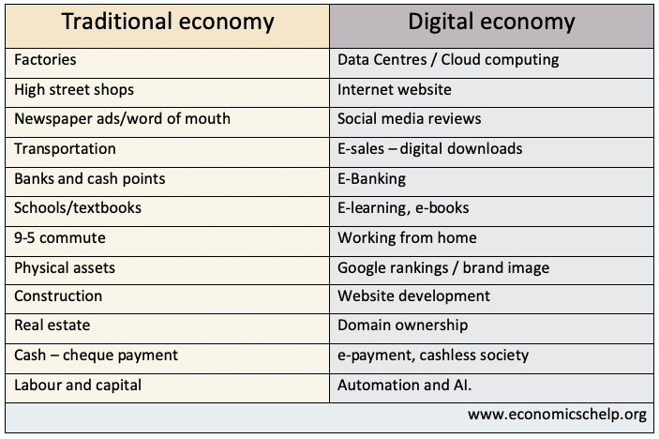

Slide 7
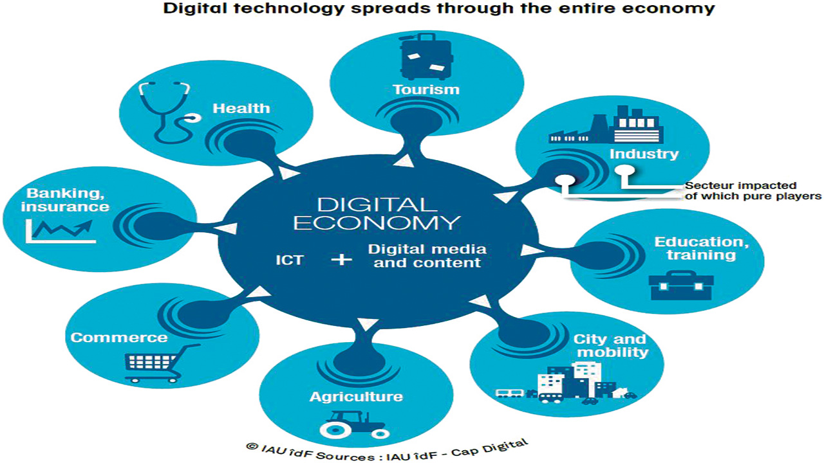

Slide 8
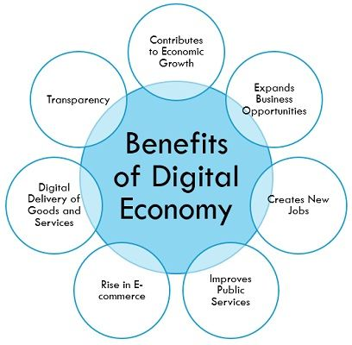

Slide 9
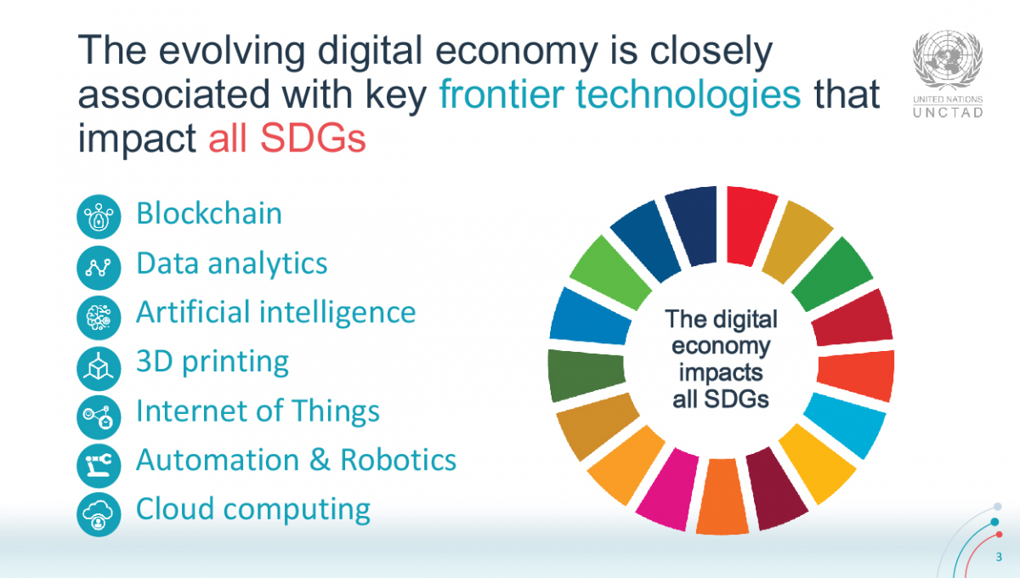

Slide 10
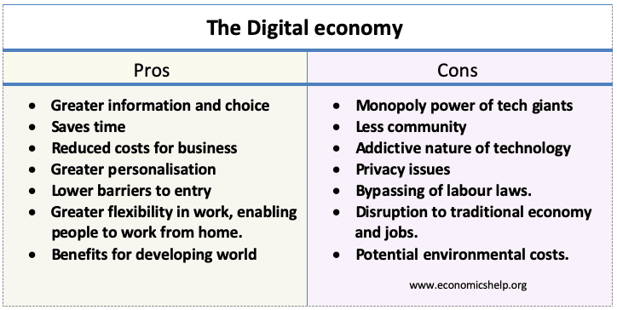

Slide 11
Merit :-
Promote Use of internet .
Rise in E-commerce .
Digital Goods and Services .
Demerit:-
Loss in employment .
Heavy investment.

Slide 12
Unit1:-Fundamental of knowledge Dimension of Economy .

Slide 13
Knowledge society
Scientific and Computer application Knowledge.
Knowledge :- Main source of efficiency , competitiveness and economy , Growth .
Knowledge society is a terms to describe societies which are economically and culturally characterized by a high degree of dependency on their potential to create scientific and technological knowledge.
It is a society whose economy depends on the knowledge of the citizens , the success of this society depends on innovation and creativity of the citizens.
It focus on knowledge generation which the help of ICT(Information communication and technology ) .
It is used interchangeably with notions such as ‘knowledge economy ’ , ‘knowledge driven economy ’ and ‘economy of innovation ’.

Slide 14
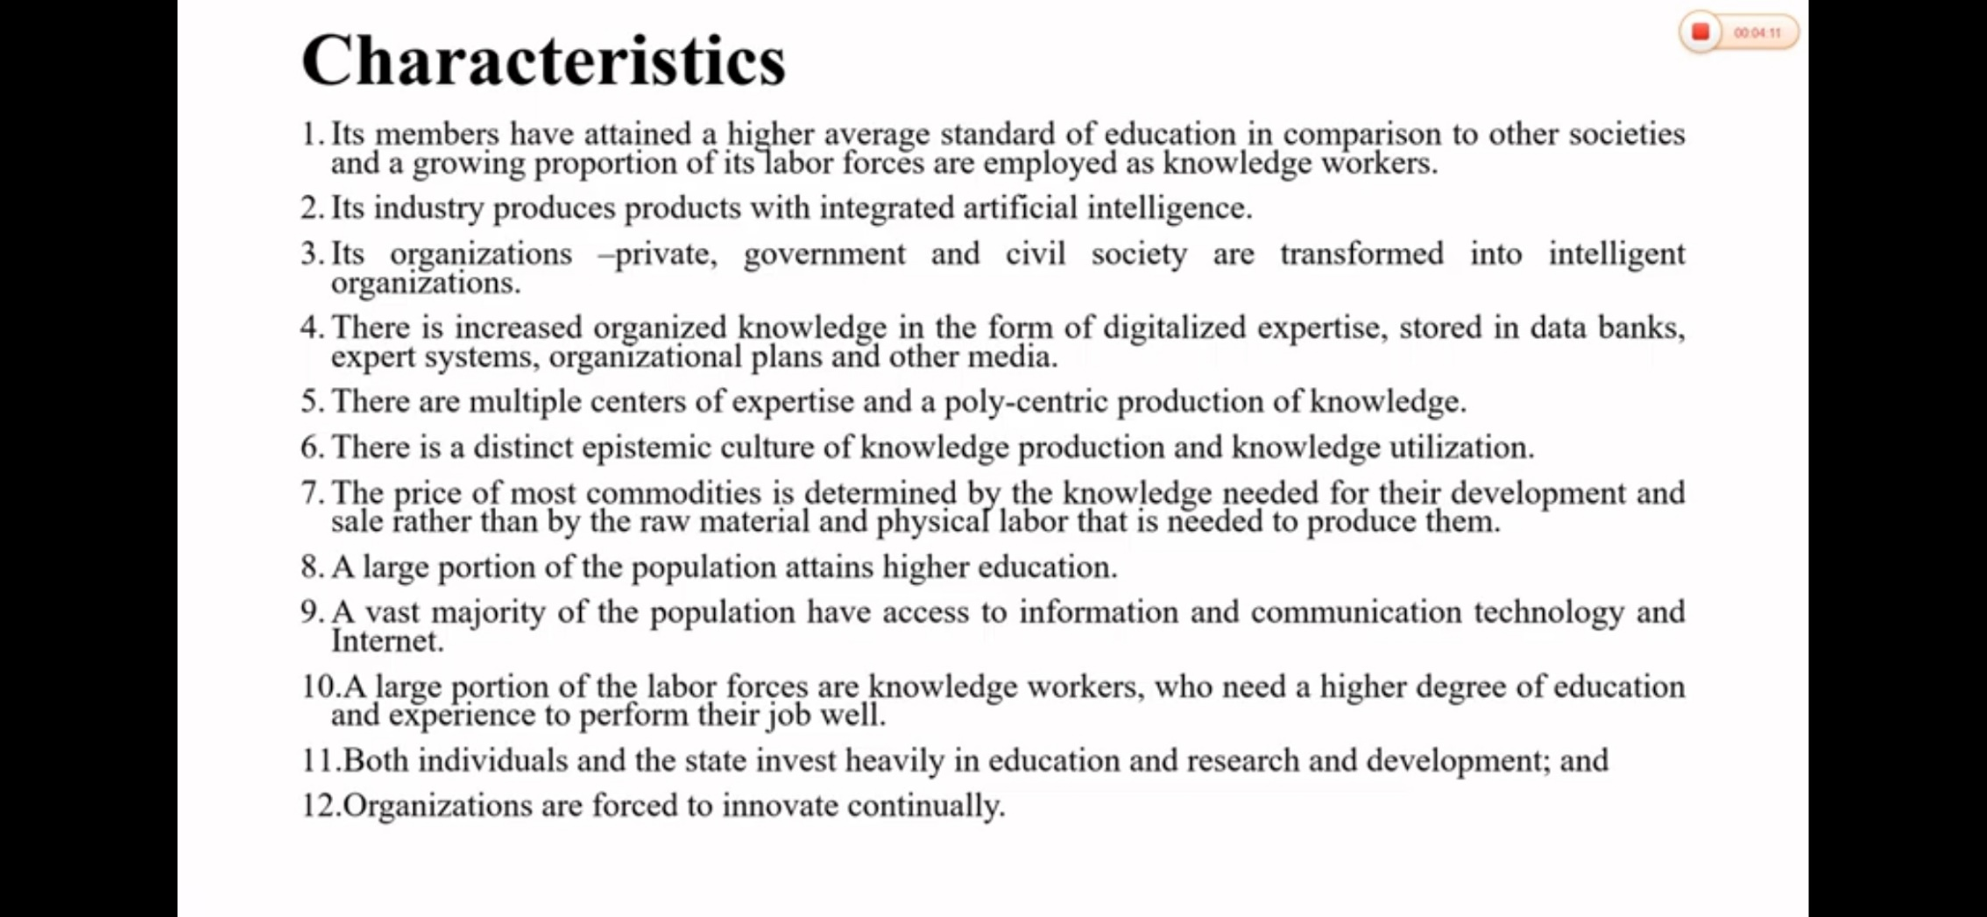

Slide 15
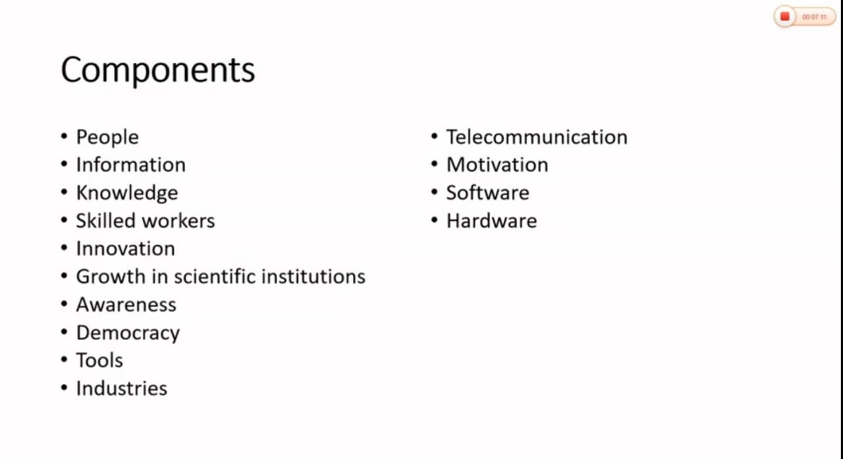

Slide 16
Information society
A society in which information , rather than material good , has become the chief economic , social and cultural motor .
An information is a society where the creation , distribution , use , integration and manipulation of information is a significant economic , political and cultural activity .
The aim of information society is to gain competitive advantage internationally , through using information technology (It ) in a creative and productive way .
Ever since the 1950s ‘information society ’ has been one of the key terms used to describe today world .

Slide 17
Criteria of Development information society .
Technological Criteria : Today age is the computer age in which computer and telecommunication are behind other change in the society . Communication technology such as tele-education ,teleconferencing , teleshopping ,telecommunicating , e-government e-commerce. have covered the world into a global village and its impact can be felt at every level of our society .
Economy Criteria: this is the age of knowledge(key) in which knowledge capital would predominate over material capital. The internet is fundamentally charging the way the companies operator . The internet is turning the business upside down and inside out . The e-commerce goes far beyond the buying and selling over the internet . The information worker are replacing productive worker as the biggest sector in the economy.
Social Criteria : in information society , information is the enhance of the quality of life . The information society will be conscious towards the value of information and its use will becomes increasingly covered on information handling , processing , storage and dissemination using micro electronics based technology. Globally the society has divide into two part i.e information rich society and information poor society .
Political Criteria: in information society there would be more interaction between the government and the governess through citizens participating by way of electronics poling , their access to public information under the concept of freedom and e quality.
Cultural Criteria

Slide 18
Information Cycle
Creators and information :- writers , musicians , artists ,researchers , database producers , web producers .
Information products:- books , videos , magazines ,website
Distributors of information :- publishers , internets providers , vendors
Disseminators of information :- school library , college and university , business .
Users of Information : Individual , business person , researcher , employees .

Slide 19
Characteristics of Information society .
Information Empowerment
Information consciousness
Shift from engines to computers
Shift from physical labor to mental labor
Telecommunication based information service infrastructure .
Production , use and diffusion of information through ICT.

Slide 20
Fritz nachlup (1962) : Introduce concept of knowledge society .
5 step :
Education
Researcher & development
Mass media
Information technology
Information source
Daniel Ball (1973) : introduce information society . Knowledge is the driver of social & economy growth
Development www & ICT : 1995 It was included in agenda of G7. OECD( Organization for economy cooperation and development (30 most development country ))

Slide 21
Value of Information
The characteristic of timeliness to be accuracy , effective , should also include up to date demeans current information from mistakes , errors &clear .
There may be certain situation where management is sufficient clear that no additional information is likely to change its decision . In such cases , it should be obvious that the value of information is negligible.
Five characteristic of high quality information are .
Accuracy
Completeness
Consistency
Uniqueness
Timeliness
Component of information :
Computer & hardware
Computer s/w
Telecommunication
Database & Data warehouse
Human resource management
To turn raw data into useful information that can be used for decision making an organization
information may cover .
market trends
buying & selling preference
customer profile
speed of processing
accurate results

Slide 22
Value Creation
Value creation is the goal of every successful business entity, creating value for customers helps you sell your products and services with ease. In the same vein, creating value for shareholders in the form of an increase in dividends and stock prices ensures the availability of investment capital to fund future operations.
Value creation in today’s world is represented by intangible assets such as brands, ideas, people, and innovation. Therefore, when broadly defined, value creation is seen as a better management tool than mere financial measures of business performance.

Slide 23
What Is Value Creation In Business To Customers, Employees, And Investors?
For a customer, it means creating products & services a customer finds consistently useful. Such value creation is based on the product, innovation process, and understanding customer needs in today’s world.
Creating value for investors involves delivering high returns on their capital consistently. This requires attractive profit margins and strong revenue growth. All these can only be achieved if a business delivers sustained value for customers.
But companies cannot deliver outstanding products and services without professional and dedicated employees. The value must also be created for employees to motivate them to give their best in achieving the overall business goals. Value for employees includes being loved, valued, and appreciated in the place of discharging their duties. They need to be respected and carried along in every decision-making process. Employees also value excellent compensation plans, meaningful work, and continued development and training.

Slide 24
Successful Value-Creation Strategies And Value Creation Models​
Actual value creation occurs when businesses develop consistent streams of products and services that offer compelling and unique benefits to a specific target audience. This means an organization must establish and maintain a specific, sustainable value creation model to maintain industry leadership.
This means an organization must establish and maintain a specific, sustainable value creation model to maintain industry leadership.
This ability to develop resources and effectively match them with opportunities is the core of any well-run business’ value to customers and the basis of its valuation by investors.

Slide 25
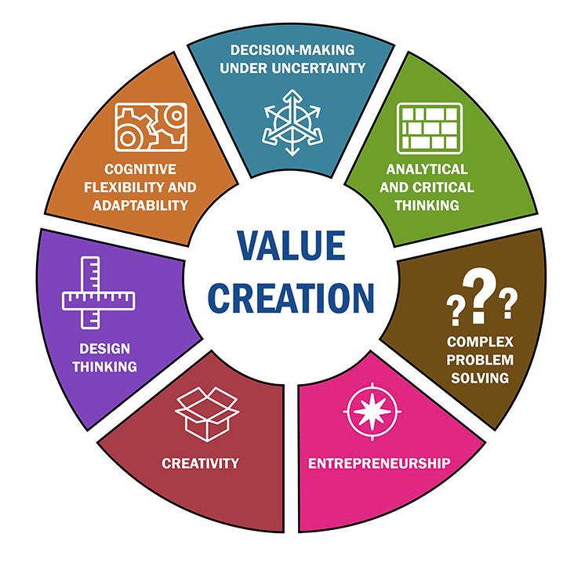

Slide 26
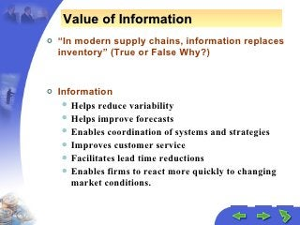

Slide 27
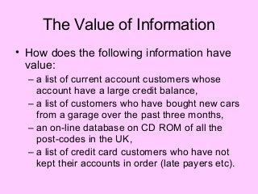

Slide 28
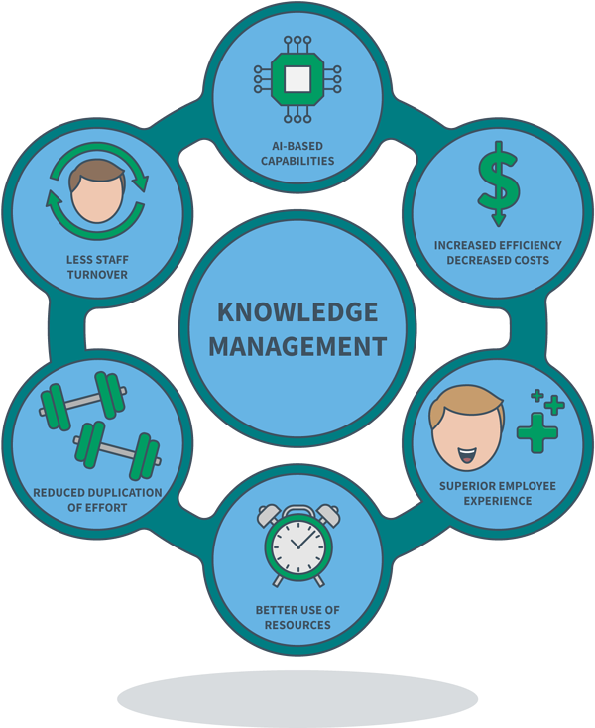
Concept of Knowledge management

Slide 29
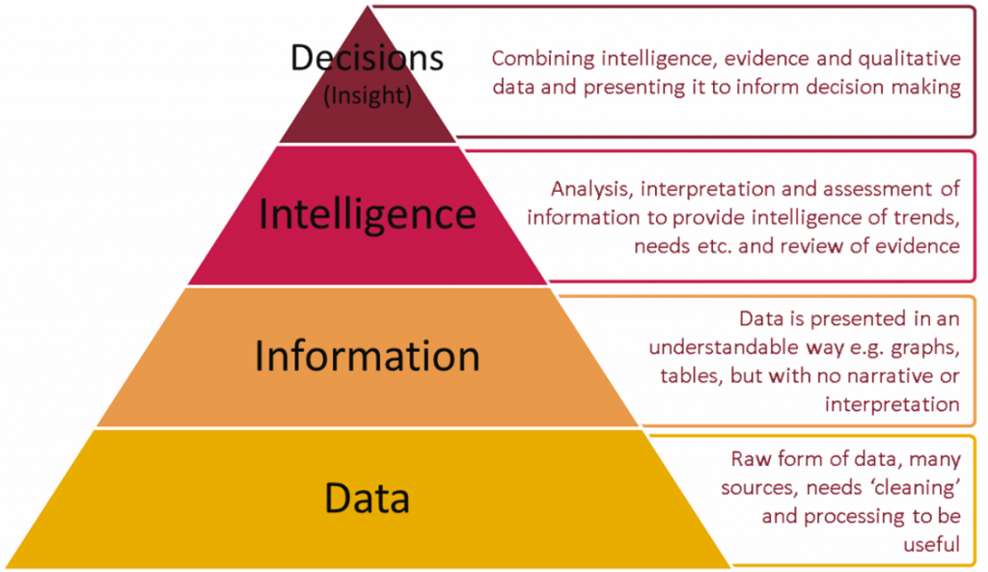

Slide 30
Data:- Collection of unprocessed fact , a set of discrete fact about event .
Information :- organizes and meaning full data .
Knowledge :- anything that is meaning full us, awareness ability process experience and imagination idea .
information that is contextual relevant and actionable .
strong experiential reflective element .
Good leverage and increasing returns.
Dynamic and evolve overtime with experience.

Slide 31
Knowledge Management
It means a process creation dissemination , upgrade and application of knowledge for organization survival.
The active management of the expertise is an organization , it involve collecting , categorizing and dissemination knowledge .
Knowledge management is the process by which an enterprise gathers, organizes, shares and analyzes its knowledge in a way that is easily accessible to employees. This knowledge includes technical resources, frequently asked questions, training documents and people skills.
Knowledge management is the process of creating , sharing , using and managing the Knowledge and information of an organization in efficient way . It refer to multidisciplinary approach to achieve organizational objective by making the best use of Knowledge .

Slide 32
What is the goal of knowledge management?
Improving organizational efficiency and saving knowledge in an easily accessible form are the main goals of knowledge management. Knowledge management aims to put the right information in front of someone at the right time.
capturing and organizing knowledge in a knowledge management system to address specific business tasks and projects;
sharing knowledge with others who can benefit from it;
improving processes and technology to provide easy access to knowledge; and
promoting the generation of new knowledge for continual learning.

Slide 33
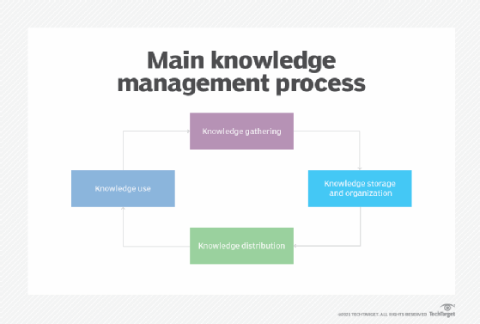
The knowledge management process
There are four key knowledge management processes. These include:
Knowledge gathering. This includes entering data, optical character recognition and scanning, pulling information from various sources and searching for other information to include.
Knowledge storage and organization. This step in the process includes cataloging and indexing content in a knowledge management system to find it, and placing links within this content to provide further related information for users to digest.
Knowledge distribution. This provides a way for users to access the information, including FAQs, training videos, white papers and manuals.
Knowledge use. Once information is distributed to users, they need to put it into action.

Slide 34
Knowledge Management Types
Tacit knowledge. :-This form of knowledge is intuitive in nature. It is based on experience and practice and often helps in achieving long-term goals. This type of knowledge transfer is difficult, as it lies with a single person. There is no easy way to extract it as with explicit knowledge, leaving the knowledge-holder with the task of writing it down or creating a video. Some examples of tacit knowledge include identifying the right moment to launch into a sales pitch or developing leadership skills
Explicit knowledge. :-This type of knowledge is codified -- meaning it is found in books, files, folders, documents, databases and how-to videos -- and is most easily extracted and handled by a knowledge management system.
Procedural knowledge
Embedded knowledge.
Concept knowledge and contextual knowledge
A posteriori knowledge

Slide 35
Benefits of knowledge management
Faster decision-making
Efficient access to knowledge and information
Increased collaboration and idea generation
Enhanced communication throughout your organization
Improved quality of information and data
More security for intellectual property
Optimized training

Slide 36
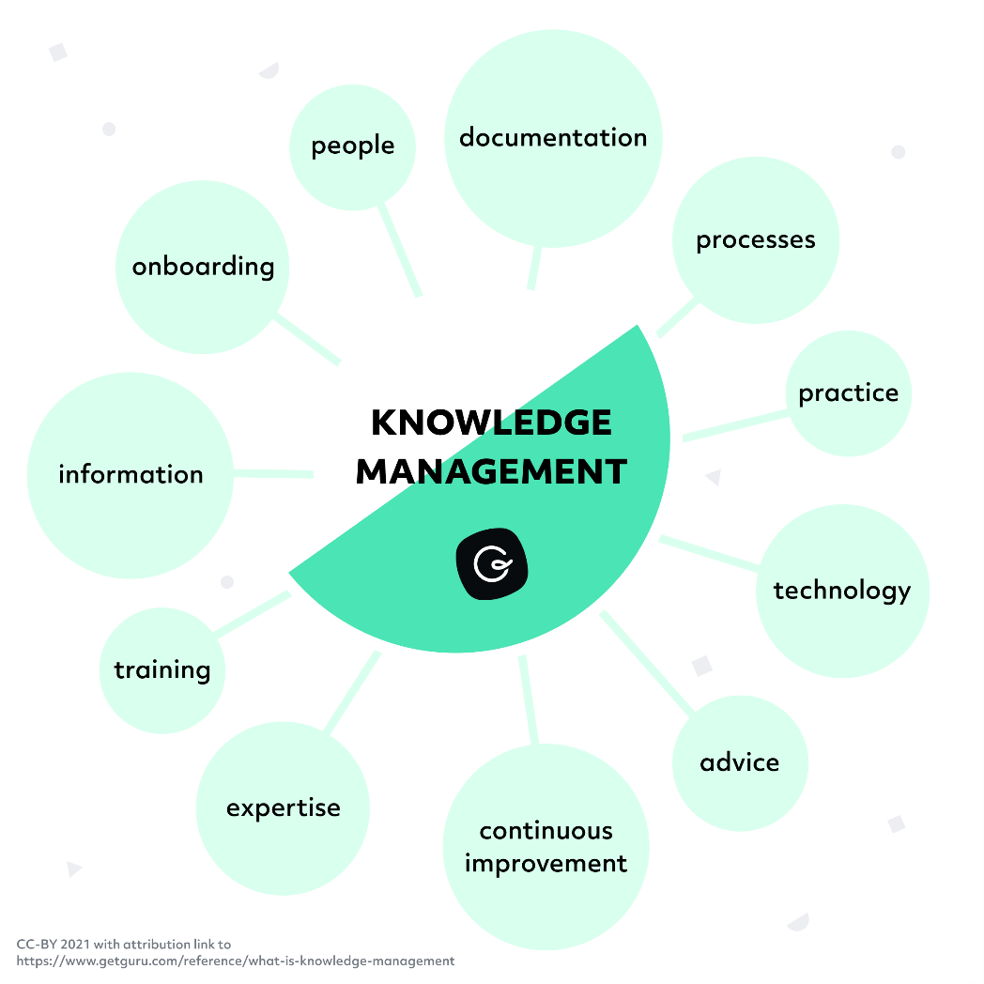
What kind of information is captured in knowledge management?

Slide 37
Examples of knowledge management
Staff retiring:-An employee’s knowledge and skillset grow as they spend time with an organization. As a result, staff typically retire with a wealth of expertise that the company needs to mine using efficient knowledge management processes in order to reduce disruption and prevent workforce knowledge gaps.
This means identifying and capturing the meaningful information that needs to be retained by the organization and determining the best approach for storing and distribution.
Employee transfer or promotion:-Employee transfer or promotion
When staff change positions within a company, they must develop additional skillsets and expertise to match their new role.
Efficient knowledge management procedures simplify delivering this information to create a seamless transition from one position to another

Slide 38
5 great knowledge management system examples
Spartan Race
Vend
Khan Academy
Canva
Tesco

